Slide 1
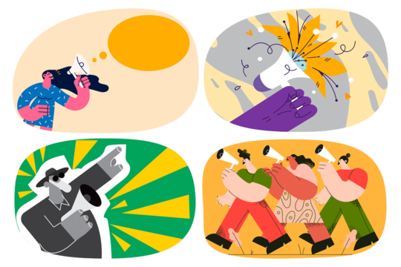
L6
Social
Problems

Slide 2
Objectives
1- to know the Features of Social Problems
2- to know the classification, causes and elements of social problems
3-to know definition and classification of crimes
4- to know the causes and effects of unemployment
.

Slide 3
A social problem is a condition that at least some people in a community view as being undesirable.
Everyone would agree about some social problems, such as murders and road traffic deaths.
Other social problems may be viewed as such by certain groups of people.

Slide 4
Teenagers who play loud music in a public park obviously do not view it as a problem, but some other people may consider it an undesirable social condition. Some nonsmokers view smoking as an undesirable social condition that should be banned or restricted in public buildings.
Every newspaper is filled with stories about undesirable social conditions. Examples include crime, violence, drug abuse, and environmental problems. Such social problems can be found at the local, state, national and international levels.

Slide 5
Sociology is primarily concerned with the study of social disorganization and social problems.
Social problems show abnormal or pathological signs in social relationships. These are the conditions that threaten the wellbeing of the society.

Slide 6
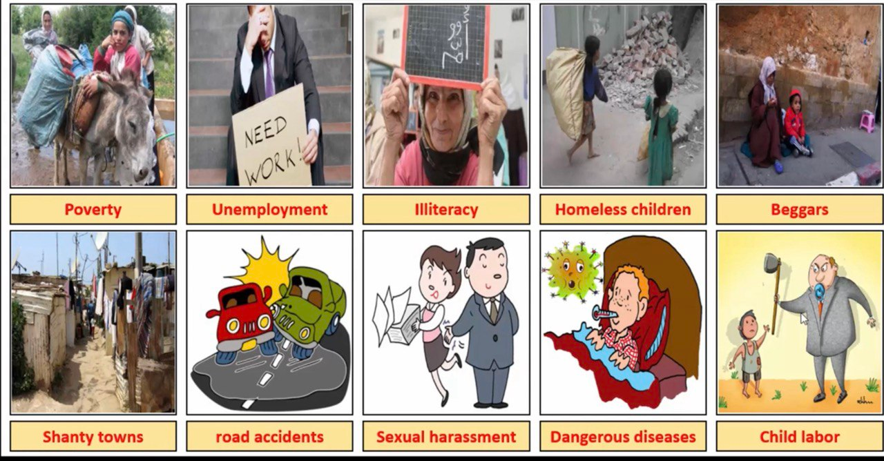

Slide 7
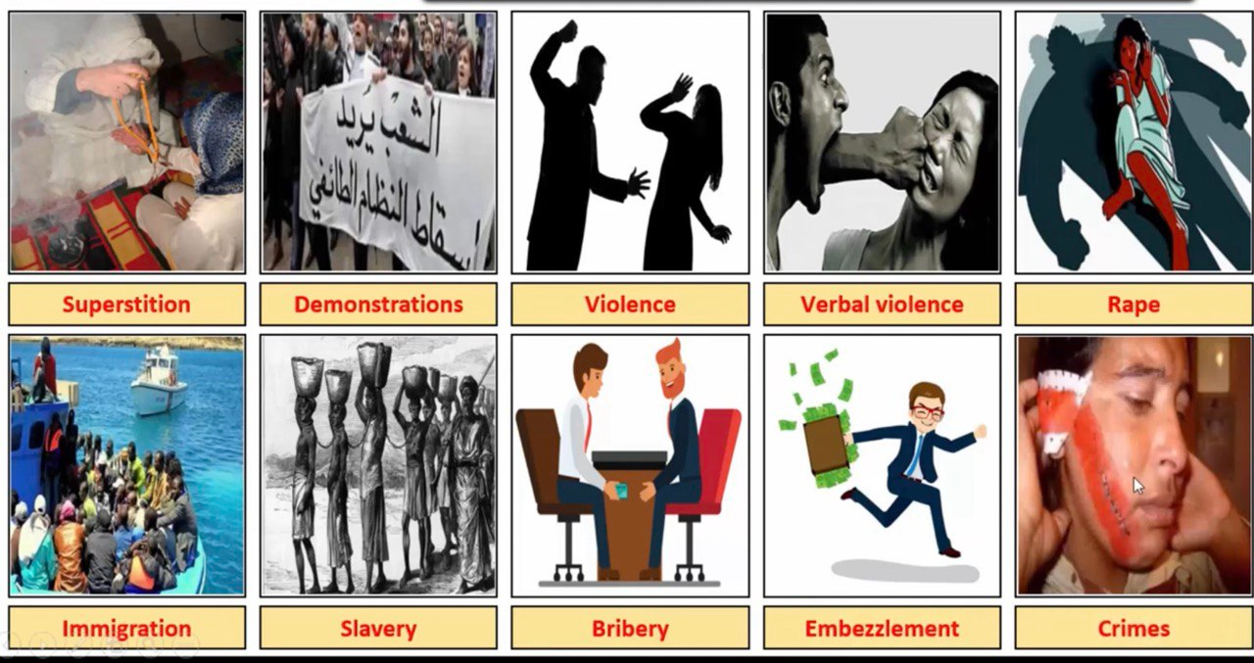

Slide 8
Cause of social problems
Generally, the following causes lead to social problems:
❑ Maladjustments among the individuals due to different social, cultural, and economic settings
❑ Ineffective means of social control
❑ Conflict of values and their degeneration
❑ Malfunctioning of social, economic, political, and religious systems
❑ Incompatible rates of social change

Slide 9
Features of Social Problems
❑ Social problems are deviations from the general norms (rules) of the society by a large number of members. This is called anomie.
❑ Social problems are common to all societies, but they vary from society to society.
❑ All social problems are interconnected.
❑ Social problems are harmful to the society. They threaten the wellbeing of the society and disrupt the social equilibrium. ❑ Social problems require collective effort for their solution. ❑ Social problems arise due to social maladjustments. They are the pathological conditions of the society

Slide 10
Elements of Social Problems
The following three elements must be identified in social problems:
They cause physical or mental damage to individuals or society.
They offend the values or standards of a large segment of society.
They persist for an extended period of time.
They generate competing proposed solutions from different groups which.

Slide 11
Factors that Define a Social Problem
HISTORY:
History changes the definition of social problems. The issues that society considered major in the past are often not that important in the present.
2. CULTURAL VALUES:
Values are a part of society’s nonmaterial culture that represent standards by which we determine what is good, bad, right, or wrong. Societies tend to define social problems according to their cultural values. For example, in countries where women’s education is devalued, it’s not seen as a social problem for girls to be illiterate. this would be shocking.

Slide 12
3. CULTURAL UNIVERSALS:
A cultural universal refers to aspects of social life common across all societies, such as births, deaths, crime, and war. In response to these issues, societies develop customs. For example, wedding ceremonies are celebrated worldwide, often featuring similar elements like fancy clothes and gatherings, despite variations in details. Similarly, social problems exist in every society, but the ways they are addressed can differ significantly across cultures.
4. AWARENESS:
The last factor that defines a social problem is awareness. Awareness is the ability of a person or group to bring a problem into public recognition. This often happens only after years of conflict.

Slide 13
Classifications of Social Problems
Some sociologists have made some attempts to classify social problems. Harold A. Phelps classified them under four categories:
Economic (poverty, unemployment, dependency, and so on),
Biological like (physical diseases and defects),
Bio-psychological like (neurosis, psychosis, suicide, and alcoholism), and
Cultural like (problems of old age, homeless and widowed, illegitimacy, crime, and juvenile delinquency جنوح).

Slide 14
Common social problems affecting individuals physically and psychologically
Crime
Crime is a great social problem facing every society. It is an act forbidden by law, and there is a penalty جزاء prescribed for it. It is the price paid for the advance of civilization. It is a major problem in modern civilized societies.

Slide 15
Classifications of Crime
❑ Crimes against body: Murder or its attempt, kidnapping, hurt, and causing death by negligence.
❑ Crimes against property: robbery, burglary السطو, theft, and extortionالابتزاز
❑ Crimes under public order: Riots اعمال شغب and arson الحرق.
❑ Economic crimes: Criminal breach of trust, cheating, and counterfeiting التزيف

Slide 16
❑ Crimes against women: Rape, cruelty قسوة by husband and relatives, sexual harassmentتحرش and importation of girls.
❑ Crimes against children: Child rape, kidnapping and of children, selling or buying of girls for prostitution, exposure and abandonment التخلي.
❑ Professional crimes: The term professional is used when offenders are highly skilled and are accorded high status among criminals. Their activities include pick-pocketingالنشل , shoplifting السرقة, burglaryالسطو, passing bad cheques , extorting money from persons in illegal sex activities.

Slide 17
Unemployment
Unemployment generally means failure of a potential individual to get an opportunity to work. One who refuses to work is also said to be unemployed. In other words, one who fails to get an opportunity to work in gainful productive activity is called unemployed.
Hence, unemployment is a condition or situation in which some capable individuals, though willing to work, fail to get a job opportunity to get some regular income for their livelihood

Slide 18
Causes of Unemployment
❑ Lack of capital and lack of investment
❑ High production or overproduction; imbalance between demand and supply
❑ Faulty economic planning
❑ Backwardness of agriculture
❑ Rapid growth of population
❑ Lack of manpower planning

Slide 19
Drug addiction
World Health Organization has defined drug addiction as a state of periodic or chronic intoxication detrimental ضارةto the individual and to society produced by repeated consumption of a drug, either natural or synthetic

Slide 20
Drug addiction
The problem of drug addiction is now a number one social problem, particularly in developed societies. The problem is becoming rampant in the world as well. It is now common to hear from the electronic media and to read from the print media that the tradition of drug usage is a growing one in many large urban centers in the country. Many have become dependent on the stimulant drug and it seems that without it some fail to efficiently carry out their tasks.

Slide 21
Control of Drug abuse or addiction
❑ Strict control over drug smuggling
❑ Change in the attitude of doctors and nurses towards drug addicts
❑ Educating people regarding drugs
❑ Attention towards the youth’s behaviour by parents, teachers, and elders
❑ Treatment of addicts
❑ Proper enforcement of constitutional and legal restraints
❑ De-addiction camps and special attention towards follow-up
❑ Checking the supply of drugs from abroad
❑ International cooperation and policy against drugs and narcotic

Slide 22
Growth of Urbanization, Urban Poverty, Housing Problem,
Homelessness and Begging
The problem of urban slums, increasing poor quality of life and poverty, shortage of basic social services such as clean water, electricity, communications facilities, housing, etc, and the growing rate of crimes and deviance. Urban slums are centers for undesirable social behaviors such as commercial sex work, theft, robbery, drug trafficking and use, sanitation problems, among others. With the growing number of urban population, access to good housing is becoming increasingly problematic.

Slide 23
The role of community in facing the social problems
It’s important to understand that social problems within a society affect its interaction with other societies, which may lead to global problems or issues. How another nation deals with the problems of a developing nation may affect its relationship with that nation and the rest of the world for years to come
No country has perfected society where all are happy and where no problems exist. Perhaps the individual nature of humans prevents this, and as many people state, perfection many not be an achievable goal.

Slide 24
Steps used in facing social problem
1-The first step is the identification of a problem. This step involves not only recognizing the existence of an issue, but also in-depth study of the problem and its history. This stage of the process often involves determining who is affected, how .aware the public is of the issue and whether it is a short or long-term concern.
2-After identifying and studying the problem, solution is usually formulated and adopted. This step is usually marked by discussion between governmental officials, interest groups, and individual citizens over how best to address the issue. The general purpose of this step is to set clear goals and list the steps to achieve them.

Slide 25
3-A third stage is the implementation of policy changes. This step usually تطبيقincludes defining the agencies and organizations involved and distributing responsibilities to each. To be successful, this stage usually requires agency communication and cooperation, sufficient funds and staff, and overall compliance to the new approach
4-The final stage in the process, known as evaluation and maintenance, is typically an ongoing one. While the importance of this step has not always been emphasized, modern policy makers often incorporate tools for evaluation into the formulation stage.

Slide 26
Quiz
1- Enumerate the Features of Social Problems
2- Enumerate the causes of unemployment
3- Define drug addition
5- What are the main methods to control drug addition
6- what are the main steps in facing social problems

Slide 27
Thank you

